Slide 1
Field epidemiology training role in strengthening health security from the local level towards the global level: EPIET and EUPHEM experiences
FETP conference, Ankara, 19/02/2025

Slide 2
ECDC Fellowship programme objectives
To strengthen prevention, preparedness, surveillance & control of infectious diseases & cross-border health threats or issues of public health concern in the EU/EEA
To enhance response capacities for communicable disease control at national & European level & response to cross-border health threats
To strengthen European & global network of public health professionals
To contribute to knowledge transfers and capacity building within EU
To reduce of disparity across Europe in infectious disease preparedness & control
To facilitate interdisciplinary & multi-sector cooperation/communication to achieve above objectives while adjusting to emerging needs.

Slide 3

EPIET programme
Two-year field epidemiology fellowship-started in 1995
To build network of epidemiologists in communicable disease surveillance & response
Learning through delivery of public health service
Public health assignments at training sites

Slide 4
Overview of programmes and paths
ECDC Fellowship (two paths) | EPIET: European Programme for Intervention Epidemiology Training (1995-) - EU track and Member State (MS) track fellows
 | EUPHEM: European Programme for Public Health Microbiology (2008-) - EU track and MS track fellows
PAE: Postgraduate Training for Applied Epidemiology, Robert Koch Institute (RKI), Germany (1995-) Greek FETP (2024-)
MediPIET: Mediterranean and Black Sea Programme for Intervention Epidemiology Training (2013-2025)

Slide 5
ECDC Fellowship Programme structure
Paths
Tracks
ECDC Fellowship Programme
Field Epidemiology
EPIET
EU and MS track
PH Microbiology
EUPHEM
EU and MS track
National FETPs
(German, Greek)
EPIET-associated programmes

Slide 6
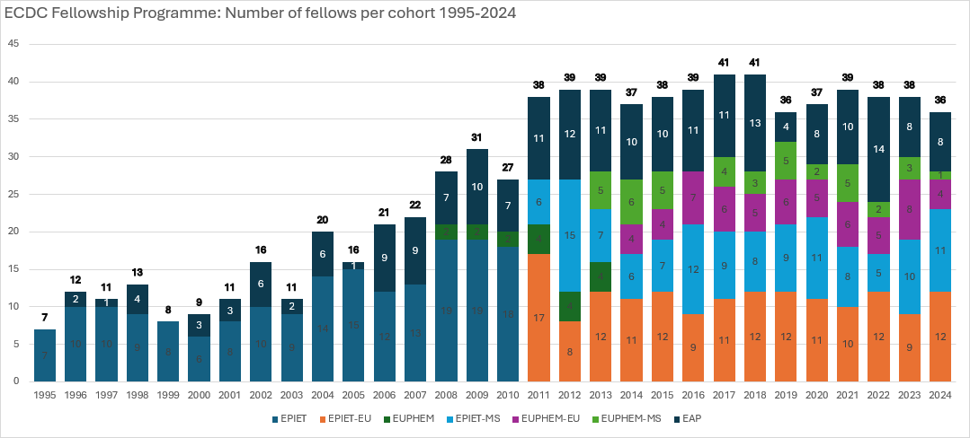
Number of fellows per cohort by EPIET & EUPHEM paths, EU- & MS-track, and EAP, 1995 - 2023

Slide 7
Overview
EPIET
EUPHEM
Modules & ESCAIDE
Governance
Roles
International missions
Curriculum
Supervision/ Training sites

Slide 8
Competencies
The fellowship will have a single list of competencies for both paths.
There will be:
Core competencies for both EPIET and EUPHEM
Core competencies for each EPIET and EUPHEM
Elective competencies
Core EPIET
Core both
Electives
Core EUPHEM

Slide 9
Competency subject areas
Competency areas
Epidemiological investigations
Preparedness, Response and Recovery
Laboratory investigations in public health
Applied public health research
Applied laboratory science
Communication
Leadership and Management
Capacity development
Data literacy

Slide 10
Curriculum–Field assignments : Intended learning outcomes
Outbreak investigations
All steps
Surveillance
Set up, analyse data or evaluate system
Applied Research (EPIET)/Applied public health microbiology investigations (EUPHEM)
Applied research (one or more)
Protocol & report
Teaching
Teach epi/ PHM to public health professionals
Communication
At least 1 submitted manuscript
1 oral presentation at ESCAIDE or other conference
Biorisk management (EUPHEM)
BSL3
Quality management (EUPHEM)
EQA/ accreditation
Laboratory investigation (EUPHEM)
Laboratory work on surveillance, outbreaks, methods
Advanced statistical analysis (EPIET)
Analyse/interpret time series data

Slide 11
Overview
EPIET
EUPHEM
Modules
Governance
Roles
International missions
Curriculum
Supervision/ Training sites

Slide 12



Training modules
  Fellowship trainings:
    ~10-12 weeks of training during the 2-year fellowship period
    Fellows choose their ‘individualised core programme’ including both core & elective modules
        Core modules (~8 weeks)
        Required elective trainings (recommended 2-3 weeks)
  Core modules = focus on essential skills / knowledge for field epidemiology and public health microbiology (e.g., R skills, WGS)
  Elective trainings = accommodate varied learning needs and interests of fellows and their training sites

Slide 13
Overview
EPIET
EUPHEM
Modules & ESCAIDE
Governance
Coordinators
International missions
Curriculum
Supervision/ Training sites

Slide 14
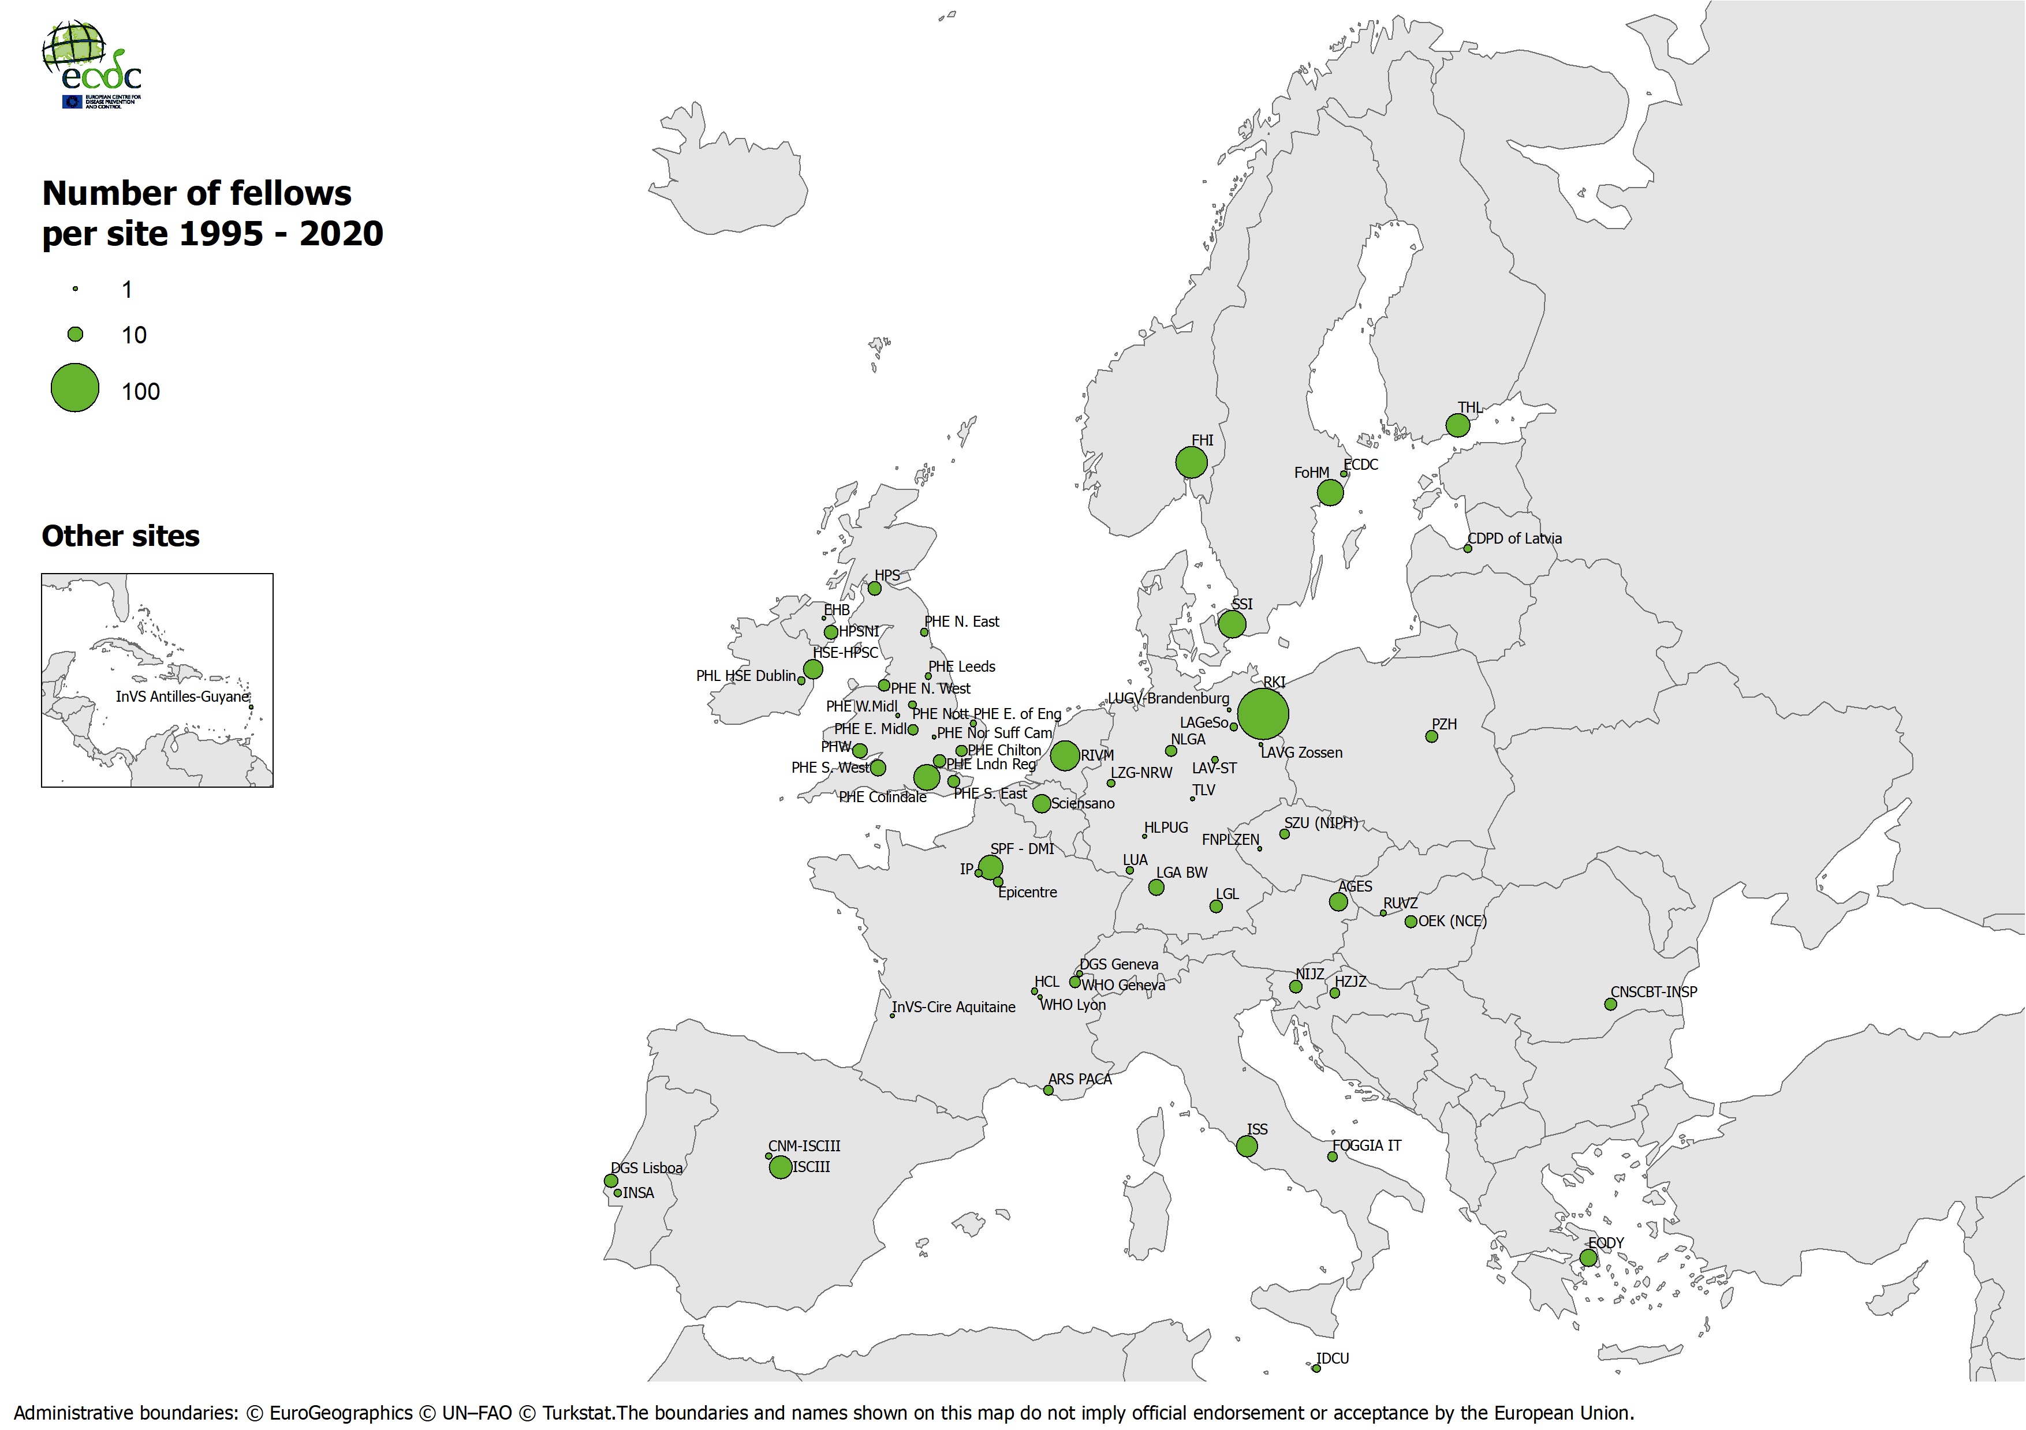

Slide 15
Training on-the-job implies supervision
Fellow
Supervisor
Scientific
Coordinator

Slide 16
Supervision cycle
1st month Competency assessment
Regular update through progress reports
13th month Midterm review
Regular update through progress reports
23rd month Exit interview
Site visit

Slide 17
Overview
EPIET
EUPHEM
Modules & ESCAIDE
Governance
Coordinators
International missions
Curriculum
Supervision/ Training sites

Slide 18
International Assignments
What?
From whom?
Assignment in other country; not programme objective, but strongly encouraged
ECDC, WHO, GOARN, Epicentre, MSF etc
How long?
4-8 weeks

Slide 19
Overview
EPIET
EUPHEM
Modules & ESCAIDE
Governance
Roles
International missions
Curriculum
Supervision/ Training sites

Slide 20
Governance
Management board (Resource allocation)
Advisory forum (strategic direction of fellowships; training needs at EU level)
National Focal Point for Training [NFPT] (Training needs at national levels)
Training Site Forum (Curricular process issues)
Head of ECDC PHT section & programmes
Coordinator team

Slide 21
Fellowship Programme governance
TRAINING SITES FORUM (TSF)
Operational Contact Points (OCP):
Main Supervisors from
all acknowledged EU/EEA Training Sites
Non-OCP members:
Scientific Coordinators
Cohort representatives
EPIET Alumni Network
Public Health Training Section

Slide 22
Overview
EPIET
EUPHEM
Modules & ESCAIDE
Governance
Roles
International missions
Curriculum
Supervision/ Training sites

Slide 23

Main partners: who does what?
ECDC
  Pay grants/salaries (EU track and coordinators) and expenses for modules and international missions
  Provide coordination
  Overall responsibility for training of fellows
Training Sites
  Host fellow, offer supervision, activities and projects
Supervisors (and Co-supervisors)
  Primary responsibility for mentoring the Fellow (4h/week)
  Teaching/facilitation in modules
Scientific Coordinators
  Overview for training of their frontline fellows
  Review all work of Fellows
  Advise supervisors on questions regarding Fellowship
  Organise training modules / courses

Slide 24
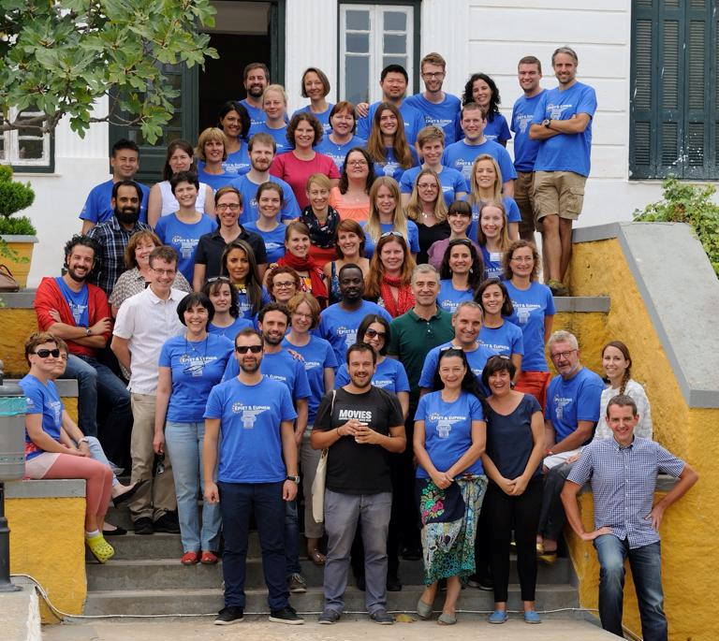



Slide 25
Thank you

